Slide 1



VK26-IITI-HT-0087

Slide 2

Title
MEDICOOL
Portable Smart Thermoelectric Medicine Storage System.

Slide 3

Problem Context
Problem Statement:
People carrying temperature-sensitive medicines may struggle to maintain required storage conditions during travel, outdoor activities, power interruptions and in places without reliable refrigeration.
People carrying temperature-sensitive medicines may struggle to maintain required storage conditions during travel, outdoor activities, power interruptions and in places without reliable refrigeration.
Core innovation:
Rechargeable, sensor-controlled thermoelectric medicine storage

Slide 4

User Journey
Visual "Before State" Requirement
User relies on ice/gel packs, an insulated bag or nearby refrigeration. Cooling duration and temperature may require close attention during travel or outages.
Baseline temperature excursions, cooling duration and user burden have not yet been quantified; establish through user research and controlled comparison.

Slide 5
User Journey
Visual "After State" Requirement
Place medicine in the insulated chamber → sensor measures temperature → controller regulates the Peltier cooling stage → display/alerts report chamber conditions.
Performance gains are not yet measured. Planned metrics: time to reach target temperature, stability, recovery after opening and battery runtime.

Slide 6






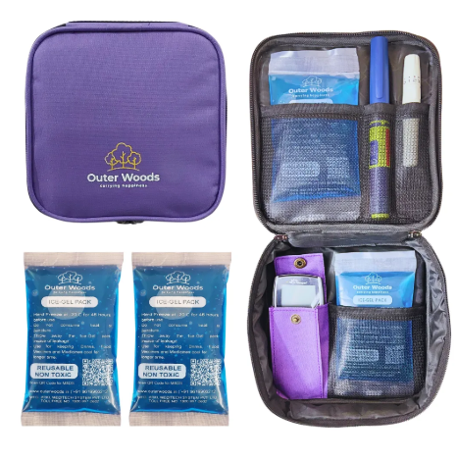
MediCool | Problem Context & User Journey
Portable
Active
Sensor
Battery
MEDICINE STORAGE
THERMOELECTRIC
FEEDBACK CONTROL
RECHARGEABLE POWER
Target Beneficiaries & Current Challenge
Target users: people carrying temperature-sensitive medicines, including insulin users, travellers and people in areas with unreliable electricity.
Current options: include ice packs, insulated pouches or access to refrigeration. Suitability depends on the medicine, journey duration and ambient conditions.
Current journey: Medicine requires controlled storage → user prepares passive cooling or finds refrigeration → temperature may change during travel or outages.
Evidence gap: Quantify the target users’ needs and baseline temperature behaviour before claiming a measurable improvement.
Figure 1: Insulin stored in pouch with ice bag
Exemplar Submission Note: Team ID: VK26-IITI-HT-0087 | Track: Health Tech| Core Innovation: Portable Smart Thermoelectric Medicine Storage System.

Slide 7


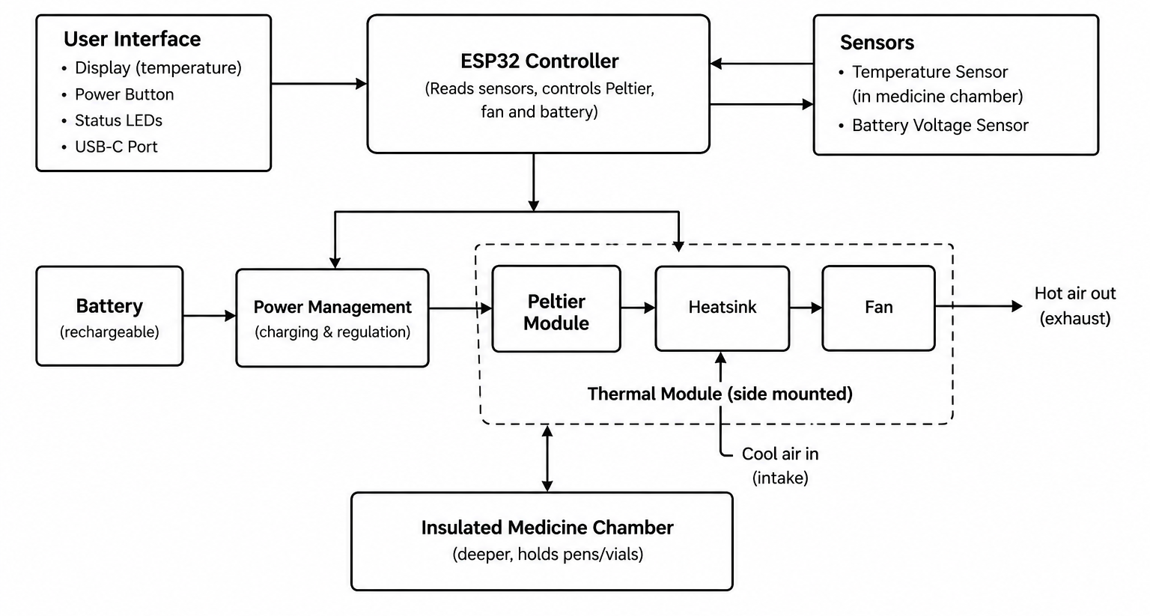
System Architecture & Specs
System Block Diagram

Slide 8


System Architecture & Specs
Target Specifications
Payload capacity: 1–2 insulin pens or equivalent vials
Operating temperature: Target 2–8°C, subject to the specific insulin’s storage requirements and validation
Temperature monitoring: Real-time sensing with automatic cooling control
Battery backup: Target 4 hours (to be validated)
Power consumption: To be determined based on the selected Peltier module and cooling load
Cooling method: Peltier thermoelectric cooling
Charging: USB-C rechargeable battery
Temperature alerts: High- and low-temperature warnings
Portability: Compact, lightweight, backpack-friendly design
Heat dissipation: Side-mounted heatsink and fan with a separate exhaust duct

Slide 9
System Architecture & Specs
Hardware Selection
Microcontroller | ESP32 — temperature monitoring and cooling control
Cooling unit | Peltier module — transfers heat away from the chamber
Temperature sensor | DS18B20 — measures chamber temperature
Heat dissipation | Heatsink + DC fan — removes heat from the Peltier hot side
Power supply | Rechargeable battery pack + BMS — portable power and battery protection
Charging | USB-C charging circuit — battery charging
Cooling control | MOSFET-based driver — switches the Peltier module
User interface | OLED display + power button and dedicated app — temperature and device status
Enclosure | 3D-printed outer shell + insulation + inner liner — structure and thermal isolation

Slide 10


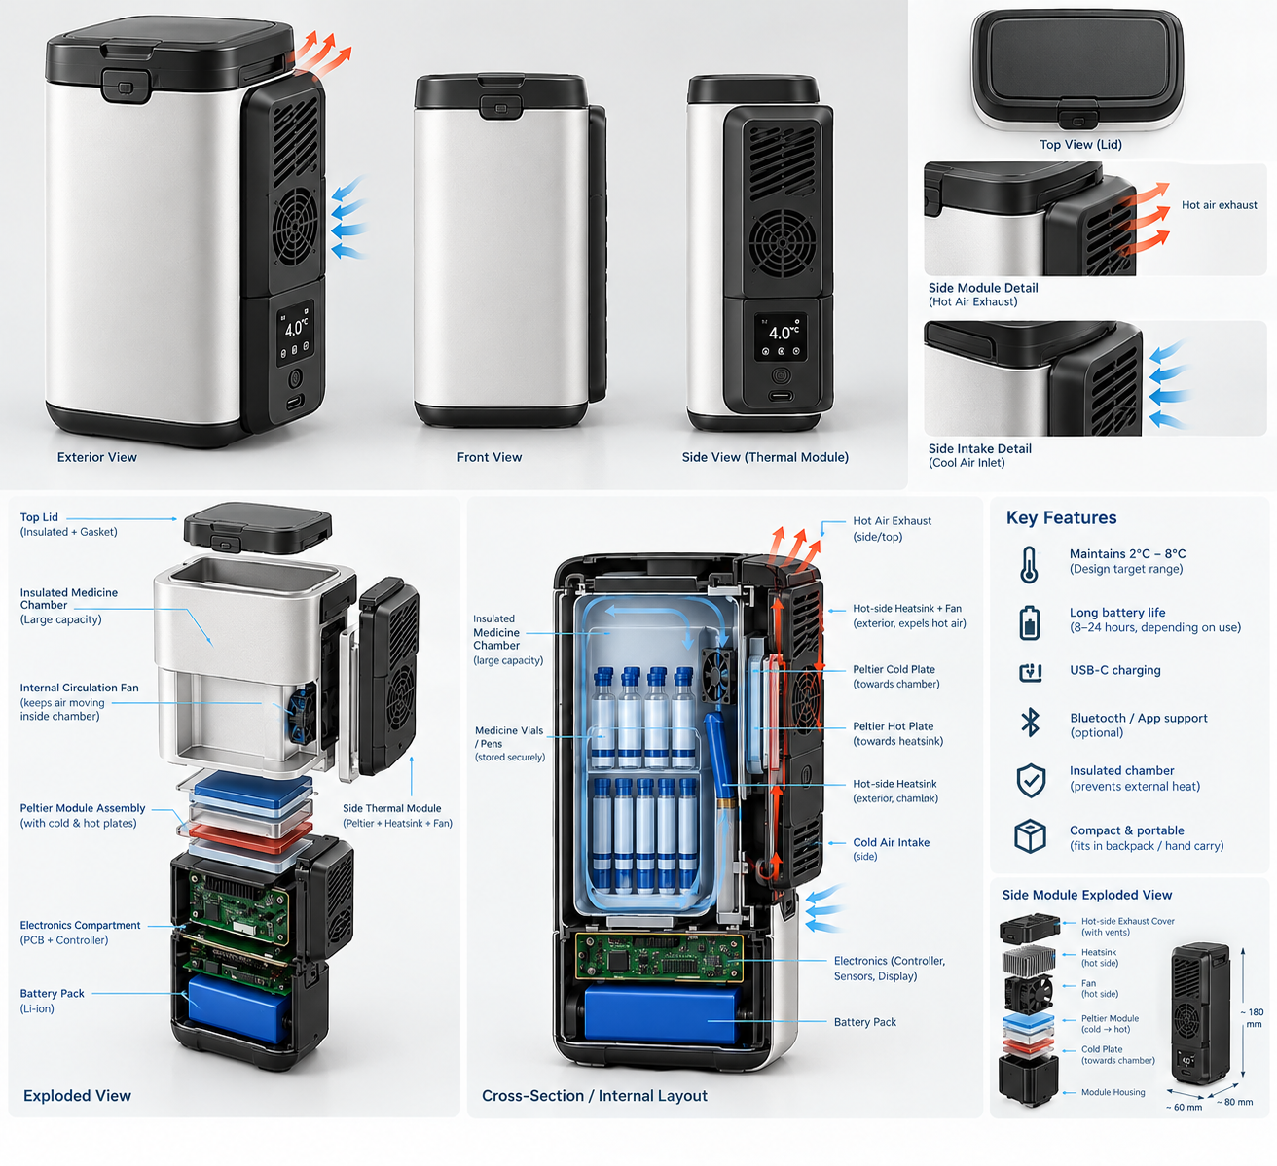
System Architecture & Specs
Engineering Target Specifications & Subsystems
Parameter | Target Specification | Selected Hardware / Protocol
Storage capacity | 1–2 insulin pens / equivalent vials | Insulated chamber with removable tray
Temperature control | Target 2–8°C, subject to insulin requirements | DS18B20 sensor + ESP32
Cooling system | Automatic cooling control | Peltier module + MOSFET driver
Battery backup | Target 4 hours | Rechargeable battery + BMS
Heat dissipation | Continuous hot-side heat removal | Heatsink + DC fan
User monitoring | Real-time temperature display | OLED display + ESP32
Figure: MediCool ,portable thermoelectric insulin storage system (concept image) .
Specifications are preliminary design targets and require prototype validation.
Architecture Rationale: CAN-bus protocol was chosen over I2C/UART to eliminate high-frequency EMI noise generated by dual rotary tine motors under heavy torque loads.

Slide 11
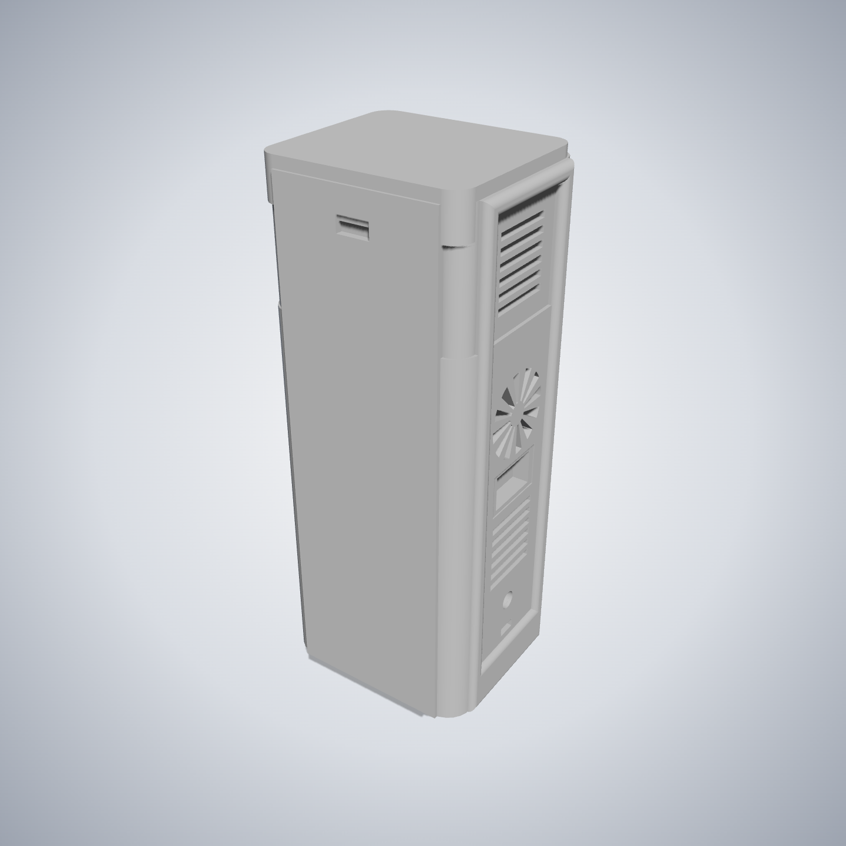
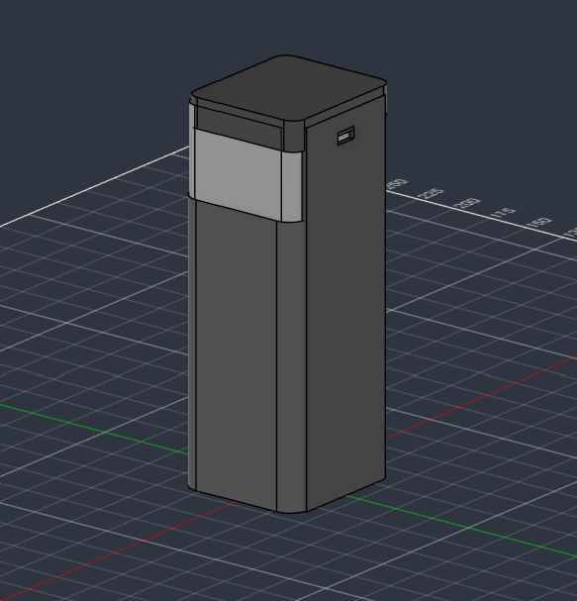
CAD Design & Mechanical Specs
Mechanical Design & Specs
Enclosure: Compact cuboid structure
Material: PETG casing proposed
Storage: Insulated chamber with removable tray
Cooling: Side-mounted Peltier assembly
Airflow: Separate intake and exhaust vents
Electronics: Dedicated lower compartment
Figure: Current preliminary 3D model of MediCool. The design is subject to further refinement and modification.
Design Iteration: The modular layout separates the medicine chamber, cooling assembly and electronics to support compact packaging, heat dissipation and easier maintenance.

Slide 12
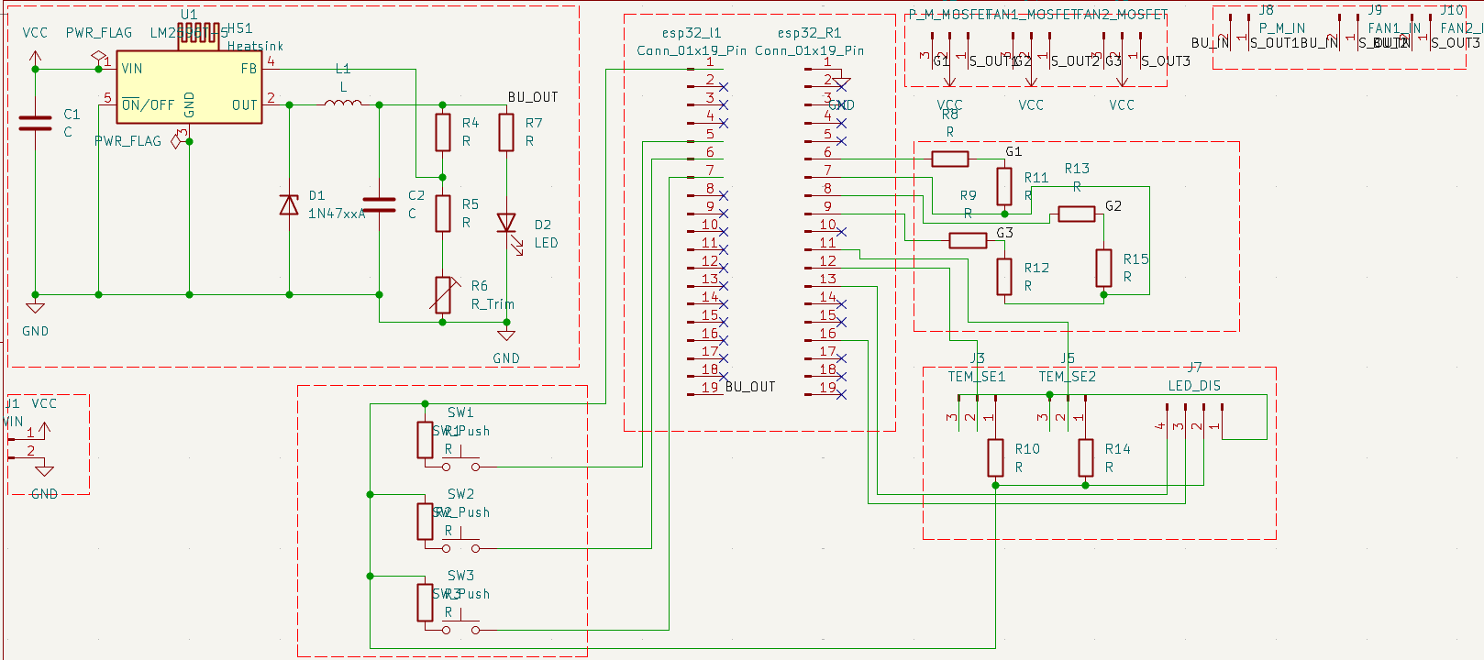
Electronics Schematics
Figure: Electronics Schematics

Slide 13
BOM
Component | Part / Specification | Qty | Lead Time | Cost (INR)
ESP32 DevKit | ESP32-WROOM-32 development board | 1 | 3–7 days | ₹450
Temperature Sensor | DS18B20 waterproof digital probe | 1 | 3–7 days | ₹100
Peltier Module | TEC1-12706 thermoelectric cooler | 1 | 3–7 days | ₹350
MOSFET Driver | Logic-level MOSFET module | 1 | 3–7 days | ₹150
Heatsink & Fan | Aluminium heatsink with DC fan | 1 set | 3–7 days | ₹350
Battery Pack | Rechargeable battery pack, capacity TBD | 1 | 5–10 days | ₹900
BMS | Compatible battery protection module | 1 | 3–7 days | ₹200

Slide 14
BOM
Charging Circuit | Compatible USB-C charging module | 1 | 3–7 days | ₹150
OLED Display | 0.96-inch I²C OLED | 1 | 3–7 days | ₹180
Voltage Regulator | DC-DC buck converter | 1 | 3–7 days | ₹120
Passive Components | Resistors, capacitors, diodes and LEDs | 1 lot | 2–5 days | ₹150
Switches | Momentary push buttons | 3 | 2–5 days | ₹30
Wiring & Connectors | Headers, terminals and hookup wires | 1 lot | 2–5 days | ₹150
Insulated Enclosure | Outer case, insulation and removable tray | 1 set | 5–10 days | ₹600
Prototype PCB | PCB or perfboard | 1 | 3–7 days | ₹200
Estimated Total |  |  |  | ₹4,080

Slide 15
Maker Journey
Prototype Development and Engineering Progress
1. Concept Development
Identified the challenge of transporting temperature-sensitive medicines when reliable refrigeration is unavailable.
Proposed a portable, insulated medicine chamber using thermoelectric cooling and temperature feedback.
2. Electronics Development
Designed the controller, temperature-sensing, power-regulation and cooling-driver circuits.
Prepared the circuit schematic and preliminary Bill of Materials.
Selected the ESP32, DS18B20 sensor, Peltier module, heatsink, fan and rechargeable power system as the proposed core hardware.
3. Mechanical Development
Planned a compact enclosure with an insulated medicine chamber and a separate hot-side cooling assembly.
Considered serviceability, heat removal, wiring access and portability in the layout.
4. Next Engineering Milestones
Complete the verified circuit and enclosure design.
Assemble the electronics and integrate the thermal module.
Test temperature regulation, power consumption, battery runtime and recovery after opening the chamber.

Slide 16
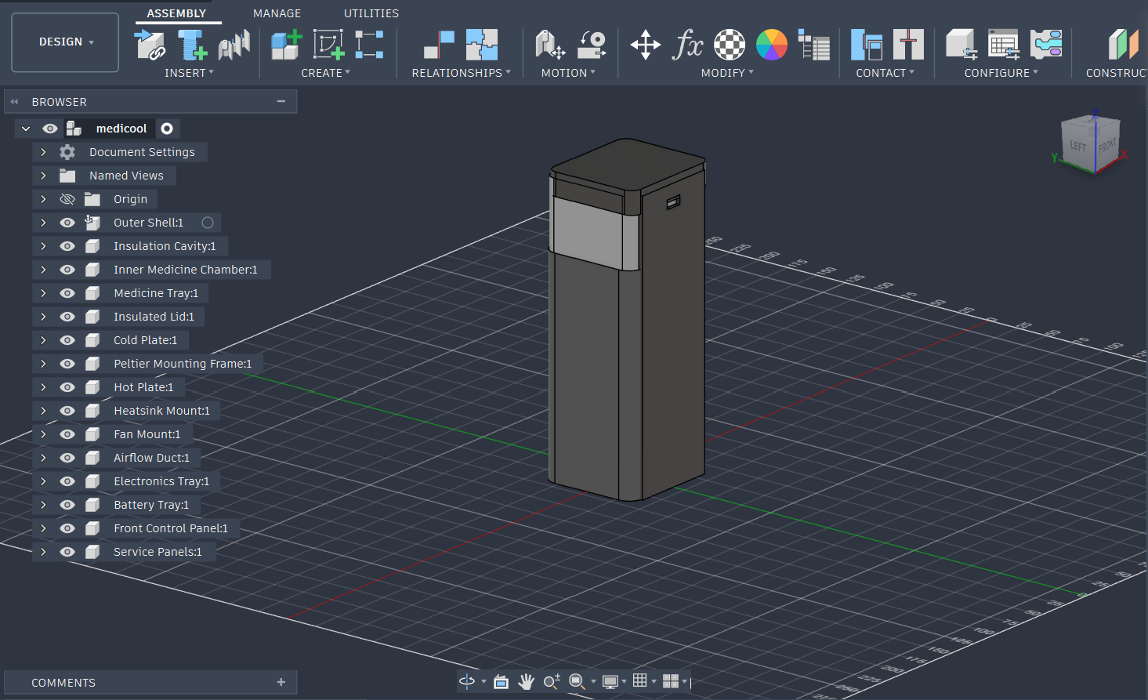
Maker Journey
Work-In-Progress
Raw Repository Linkage
https://github.com/pranaykpradeep/medicool
Figure: CAD design environment showing the development of the proposed system.
Institutional Sign-Off: Work audited and certified by Faculty Guide Prof. S. K. Kulkarni, Dept. of Mechatronics, COEP Technological University Pune.

Slide 17

Safety & Hazard Mitigation
Electrical Safety
Medicine Protection
Use a correctly rated battery protection system, fuse and insulated wiring.
Protect against short circuits, overcurrent, reverse polarity and accidental contact with live conductors.
Use a charging circuit compatible with the selected battery chemistry.
Define temperature limits according to the specific medicine's storage instructions.
Prevent the Peltier cold surface from directly contacting stored medicines.
Validate temperature uniformity inside the chamber before claiming safe storage performance.
Thermal Safety
Monitor the medicine chamber temperature continuously.
Provide high- and low-temperature alerts when the chamber exceeds configured limits.
Use a heatsink and fan to remove heat from the Peltier hot side.
Stop or limit cooling if the hot-side temperature, current or other monitored parameters exceed validated safety limits.

Slide 18

Roadmap
Month 1 — Design Finalisation
Finalise circuit schematic, component specifications and BOM.
Complete enclosure CAD and insulation layout.
Calculate the cooling load, battery capacity and heat-dissipation requirements.
Procure the essential components.
Month 2 — Fabrication and Assembly
Assemble the ESP32 control and temperature-sensing circuit.
Integrate the Peltier module, heatsink and fan.
Fabricate the insulated enclosure and install the battery and charging system.
Perform electrical continuity and power-up checks.
Month 3 — Firmware and System Integration
Implement temperature monitoring and automatic cooling control.
Integrate the OLED display and temperature alerts.
Test sensor readings, cooling response and power consumption.
Correct wiring, thermal and firmware issues identified during testing.
Month 4 — Testing and Demonstration
Measure time to reach the target temperature.
Evaluate temperature stability and recovery after opening the chamber.
Measure battery runtime under defined test conditions.
Document results, complete safety checks and prepare the Stage 3 demonstration.

Slide 19

Safety by Design
Failure mode | Potential consequence | Mitigation
Temperature sensor failure | Incorrect temperature measurement | Validate readings and detect sensor disconnection or invalid data.
Peltier overheating | Reduced cooling performance or component damage | Use a properly rated heatsink, fan and thermal shutdown logic.
Battery undervoltage | Unexpected system shutdown | Monitor battery voltage and provide a low-battery warning.
Short circuit or excessive current | Wiring or component damage | Add suitable fuse protection and verify current ratings.
Poor chamber insulation | Excessive power consumption and unstable temperature | Seal thermal gaps and evaluate insulation performance.
Temperature exceeds limits | Medicine may be exposed to unsuitable conditions | Trigger an alert and record the temperature excursion where supported.
Failure mode | Potential consequence | Mitigation
Temperature sensor failure | Incorrect temperature measurement | Validate readings and detect sensor disconnection or invalid data.
Peltier overheating | Reduced cooling performance or component damage | Use a properly rated heatsink, fan and thermal shutdown logic.
Battery undervoltage | Unexpected system shutdown | Monitor battery voltage and provide a low-battery warning.

Slide 20
Technical Challenges & Risks
Thermal Management
Maintaining the target 2–8°C chamber temperature under varying ambient conditions.
Preventing heat accumulation on the Peltier module's hot side.
Battery Runtime
Balancing Peltier power consumption with the target 4-hour battery backup.
Managing battery capacity, peak current and overall device weight.
Temperature Stability
Preventing temperature fluctuations when the lid is opened.
Ensuring uniform cooling throughout the medicine chamber.
Electronics Integration
Integrating the ESP32, DS18B20 sensor, MOSFET driver and power-management circuit.
Protecting against sensor failure, overcurrent and battery undervoltage.
Key Technical Risks
Insufficient cooling: Inadequate heatsink capacity or poor insulation.
Short battery life: Higher-than-expected cooling power demand.
Temperature excursion: Sensor faults or delayed cooling response.
Component failure: Excessive current or inadequate electrical protection.

Slide 21
Potential Solutions & Risk Mitigation (1 Slide)
Temperature Control
Power & Heat Dissipation
Risk: Temperature may fluctuate or fall below the required range.
Mitigation: Use sensor-based feedback control, temperature alerts and independent temperature monitoring during testing.
Risk: High power consumption, battery depletion or overheating on the hot side.
Mitigation: Select a suitably rated battery with protection circuitry, and use a heatsink, fan and separated airflow path.
Sensor or System Failure
Medicine Safety
Risk: Sensor faults or controller failure may interrupt cooling.
Mitigation: Detect invalid sensor readings, trigger fault alerts and test safe shutdown or fallback behaviour.
Risk: Poor insulation, condensation or accidental freezing may affect storage conditions.
Mitigation: Use an insulated, sealed chamber and validate temperature uniformity, condensation control and low-temperature cut-off.

Slide 22



Example: Technical Challenges & Risks
Bottleneck: Wet Soil Clogging
Bottleneck: Thermal Throttling
Standards & Enclosure Specs
Observed Risk: High-moisture (>25%) black cotton soil adheres to rotary cultivator teeth, causing rotational binding within 12 minutes of continuous furrow tilling.
Observed Risk: Hub motor temperatures reached 68°C in simulation during sustained noon operations at 38°C ambient Maharashtra field heat.
ISO 4254-1 Compliance: 2mm sheet steel blade shrouds eliminate projectile pebble hazards.
IP65 Ingress Sealing: Gasket-sealed ASA electronics bay with IP68 PG7 cable glands tested against direct pressurized spray.
Mitigation: Installed stationary low-friction PTFE scraper blades offset 1.5mm from the tine arc to dynamically peel away clay buildup on every rotation.
Mitigation: Retrofitted extruded radial aluminum heatsinks directly coupled via 3.0 W/mK silicone thermal pads, stabilizing motor casing temps below 47°C.
IEC 62133: BMS equipped with cell-level thermal sensors and overcharge isolation.
Empirical Verification: Benchtop clay test rig showed a 94% reduction in mechanical rotational drag after installing the PTFE scraper combs.

Slide 23


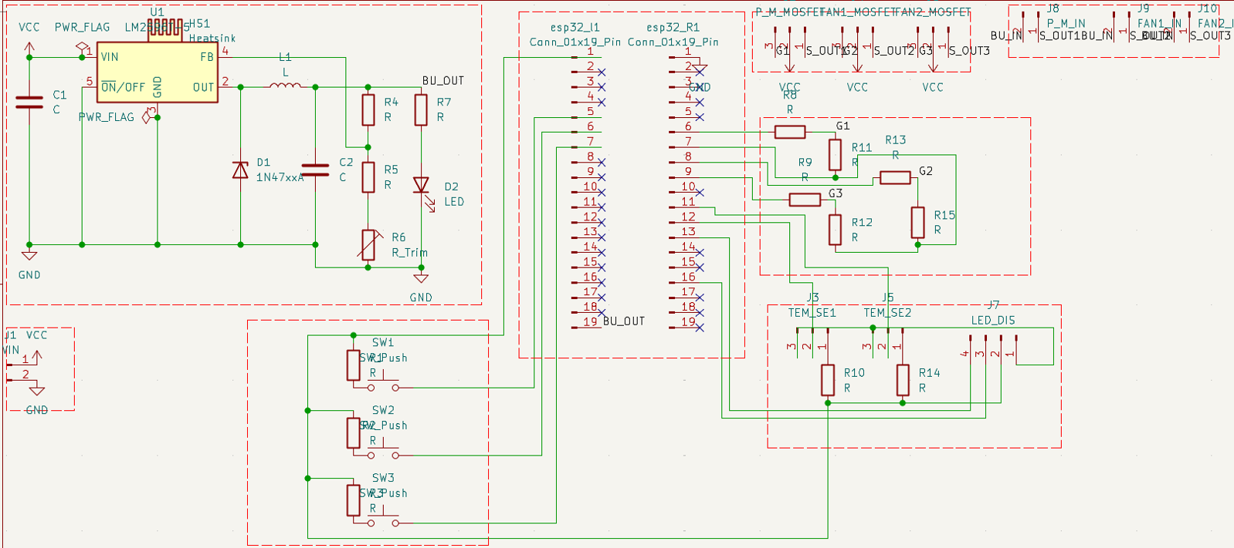

Image Sources
https://www.flipkart.com/outer-woods-insulin-cooler-travel-bag-diabetics-two-ice-gel-packs-pack/p/itm0fca7d4816eb5
Source: www.flipkart.com
Ai concept image.
Source: chatgpt
3d design .
Circuit diagram
3d designing interface with work tree

